Slide 1
Neoliberalism

Slide 2
Neoliberalism Compared to What
Internationalization and extensification of Fordist production
Strong central states to regulate macroeconomy
Prevalence of public/private corporations, so-called “mixed economies”
Multilateral institutional order regulating investment, security and exchange
High wage regime for blue collar industrial manufacturing, basis of “affluent society” thesis

Slide 3
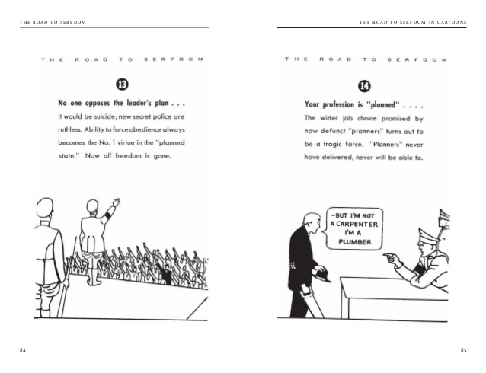
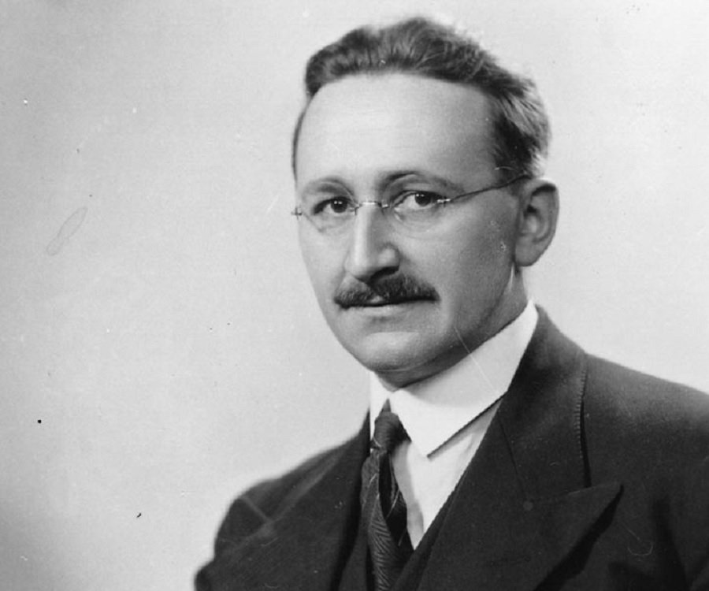
Friedrich von Hayek
Austrian economist
1944 Road to Serfdom argued planning was necessarily incompatible with freedom
Instantly generated a small but dedicated group of follwers

Slide 4
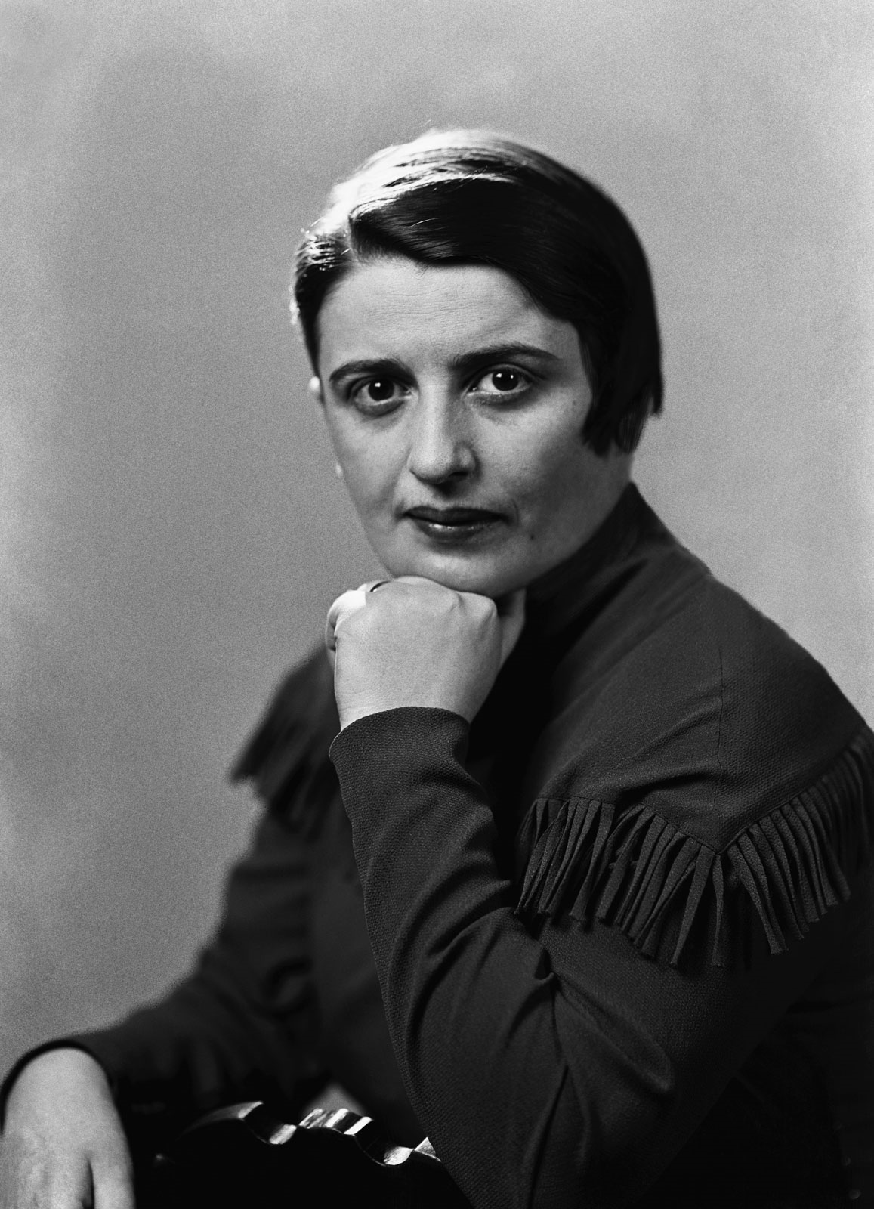
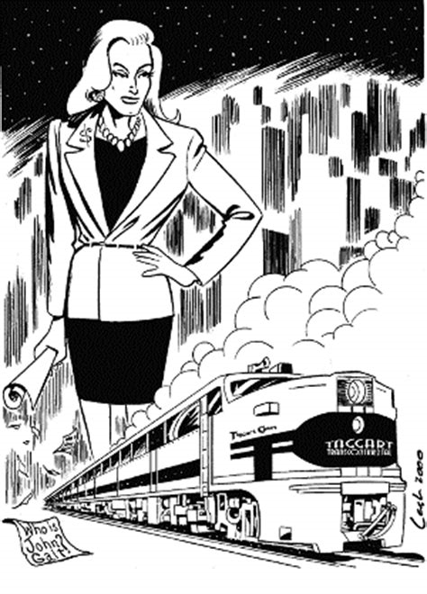
Ayn Rand
Russian expatriate
Novelist
Amateur philosopher
Argued altruism is actually selfishness, and collectivism is a form of despotism
Novels Atlas Shrugged, The Anthem, and Fountainhead featured strong entrepreneurs destroying the system by withholding their expertise
Atheist, at tension with the religious right

Slide 5
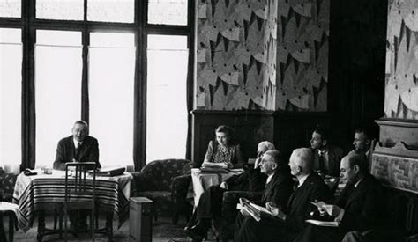
Mont Pelerin Society
Intellectual organization (economists , philosophers, political scientists) dedicated to the ideas of Hayek
First meeting in 1947 called to recognize and combat the prevalence of collectivist thought, Included:
Karl Popper, theorist of “the open society”
Milton Friedman and George Stigler, pioneers of “Chicago School” price theory

Slide 6
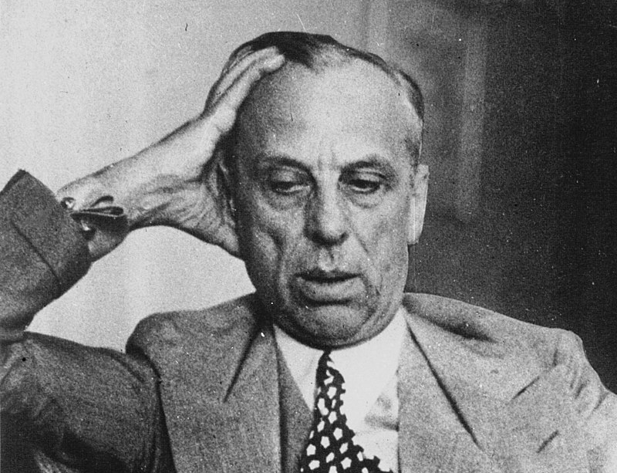
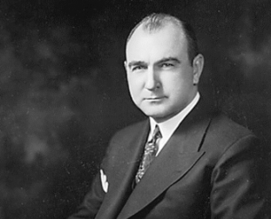
Business Leaders Against the Class Compromise
Many CEOs in companies with strong unions and/or communist-influenced workers never accepted class compromise
GM CEO Alfred Sloan was anti-labor and believed economic elites are on top through hard work and superior skill
GE CEO Lemuel Boulware was opposed to Communist-led UE and friends with Ronald Reagan by the early 1950s
Formed Business Roundtable to advocate positions

Slide 7

Decline of Manufacturing Hegemony
1971- First US trade deficit of the twentieth century
1970-1980- Manufacturing employment fell from 38 to 28 percent
1971- Nixon reneges on gold convertibility
1970s- Japanese kaizen advances upon fordism

Slide 8
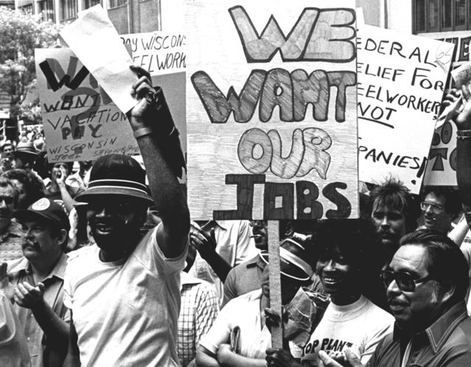
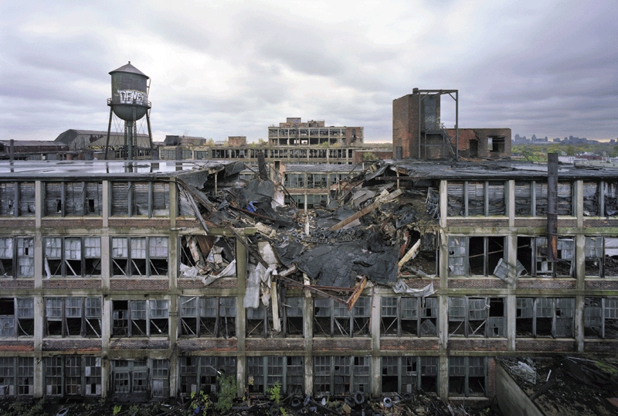
Deindustrialization
1970-1980- Detroit and Chicago lost half of their manufacturing jobs

Slide 9
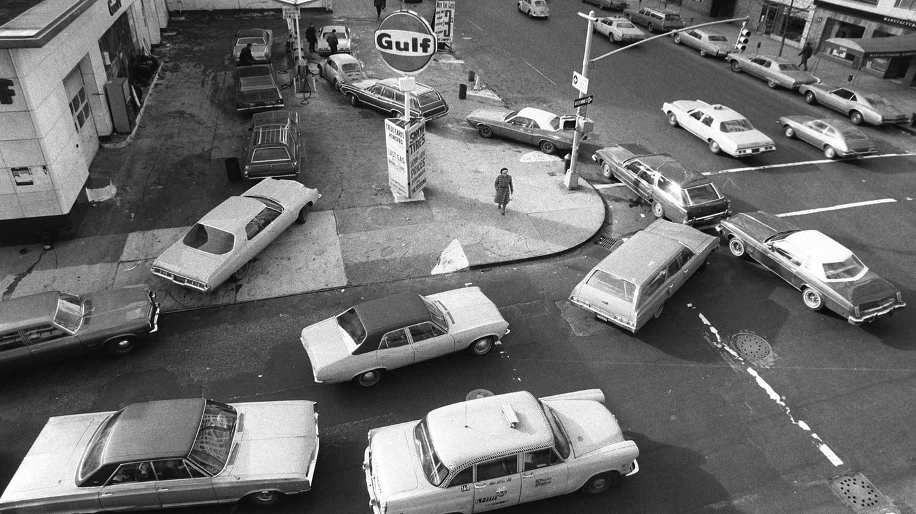
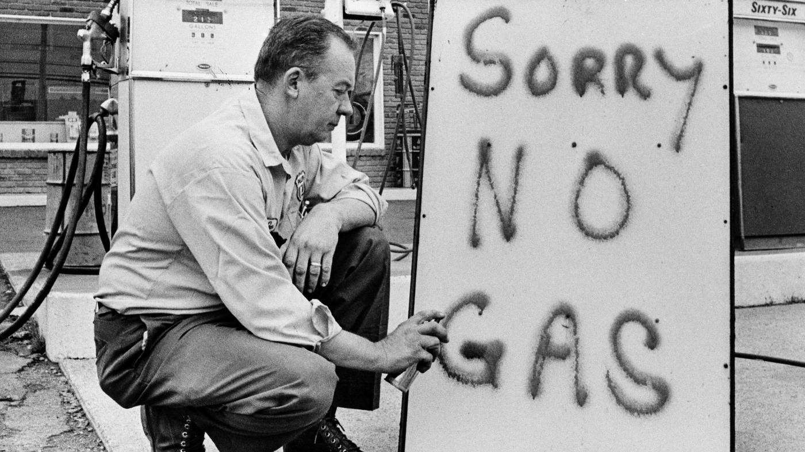
Oil Crisis and Stagflation
OPEC formed in 1960
Israel/Egyptian war stanched import of oil
1973 oil embargo
1973-1981- 10 percent inflation, 2.4 percent growth
1970-1980- “misery index,” sum of unemployment and inflation rates, doubled from 10.8 to 20

Slide 10
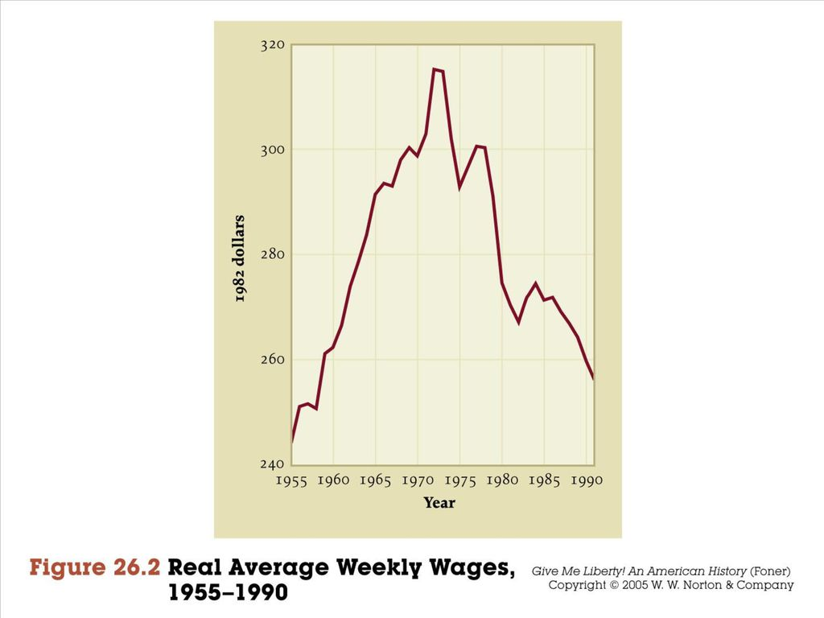
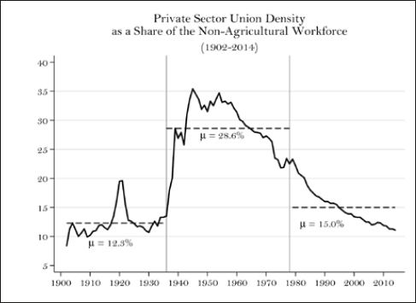
End of the High Wage Regime

Slide 11
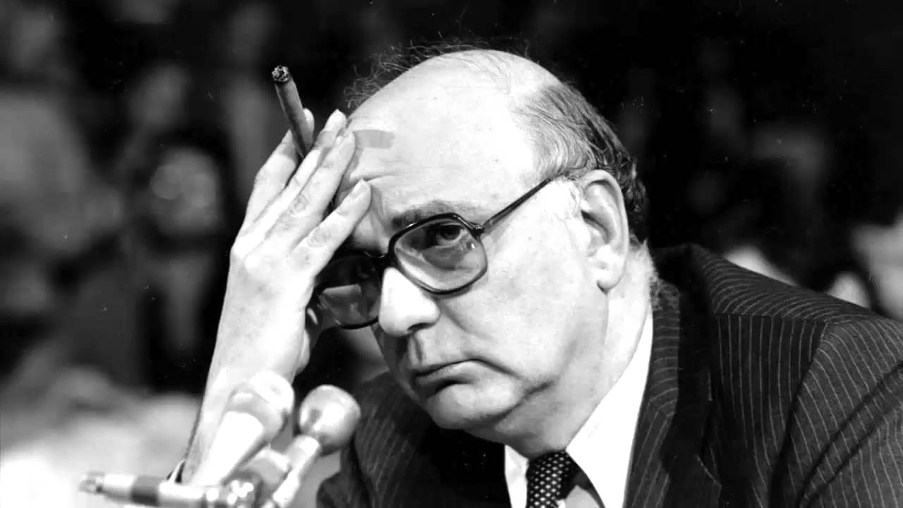
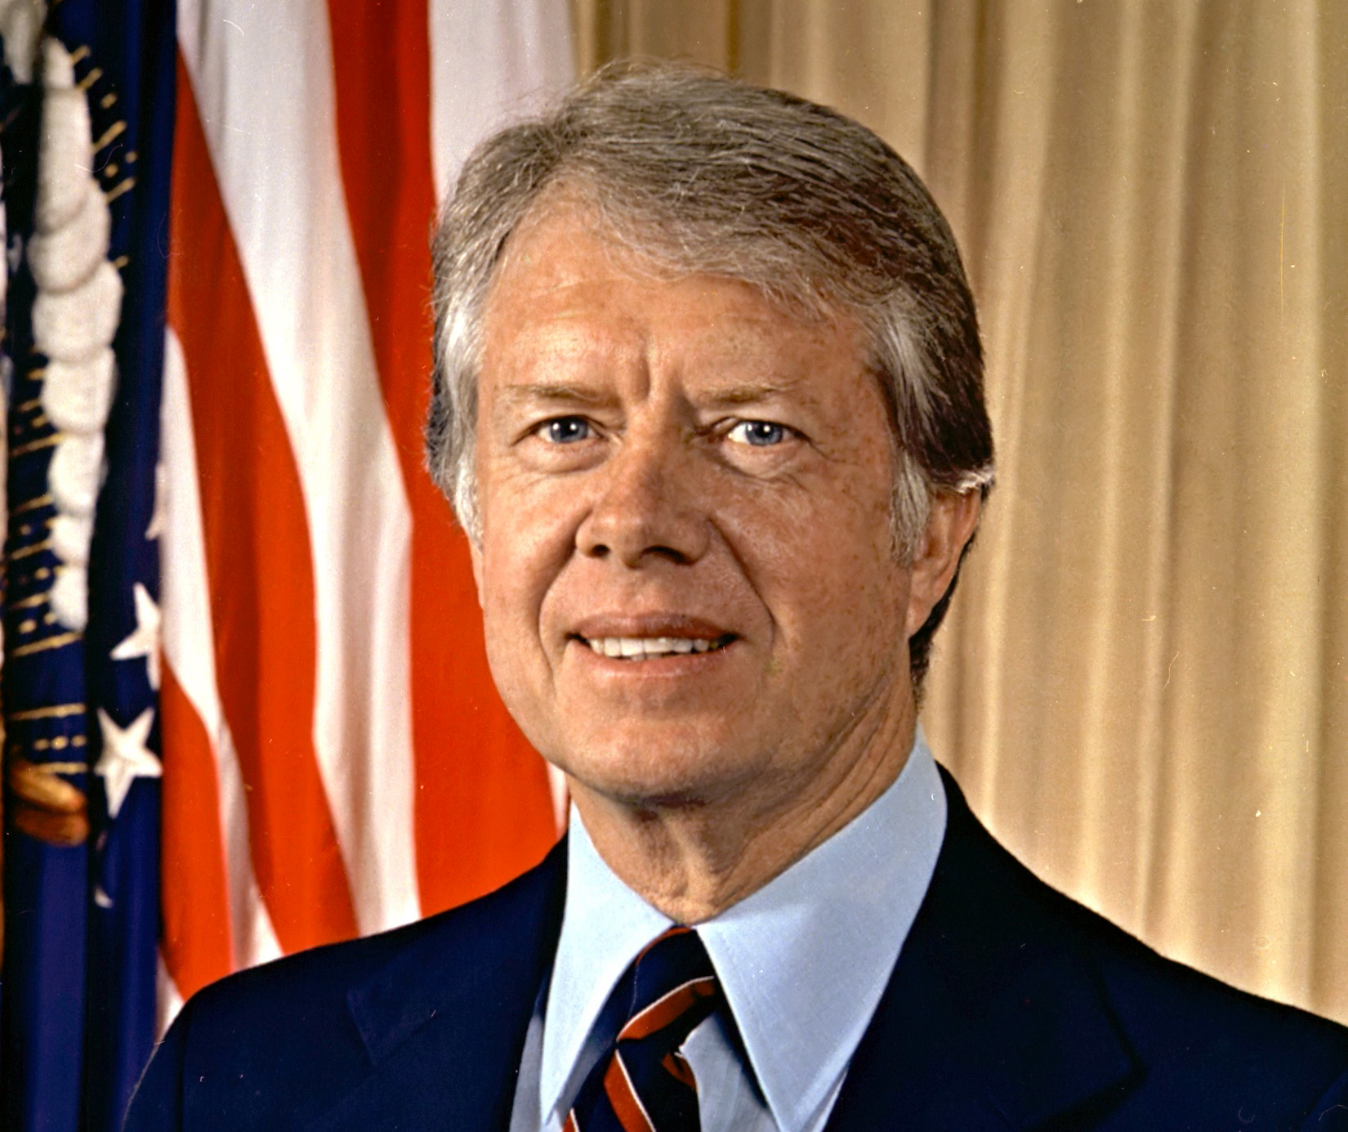
The Carter Recession and Volcker Shock
Stagflation overshadowed Carter’s entire presidency
Beginning in 1979 Fed Chairman Paul Volcker implemented rates hikes to “shake out” inflation
As world reserve currency, interest rate hike affected all countries
Precipitated Mexican Peso Crisis of 1982, followed by frequent defaults

Slide 12
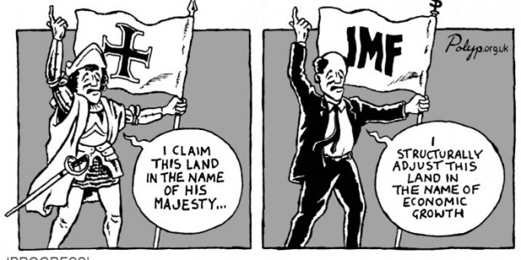
The Washington Consensus
IMF provides loans to countries who default on their debts
Demands “structural adjustment” in return, which includes privatization, deregulation, fiscal austerity, and union-busting

Slide 13
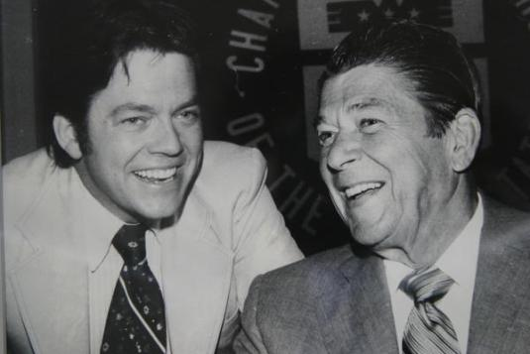
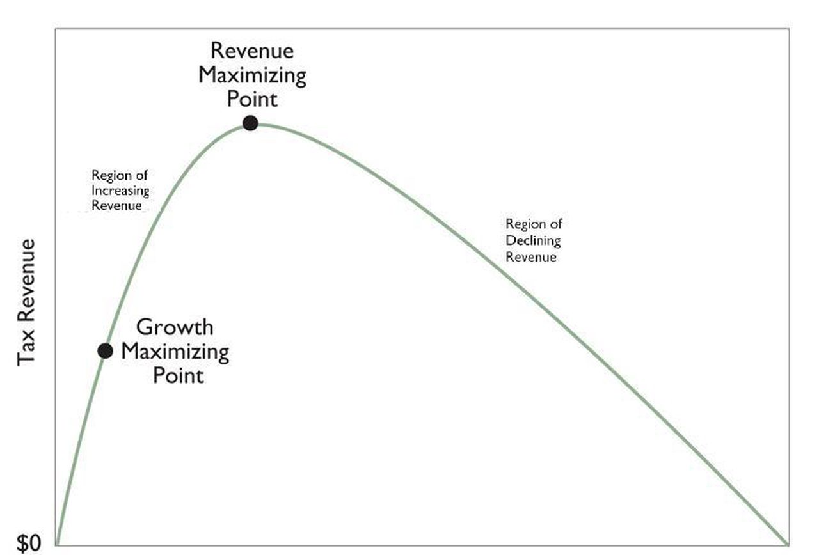
Supply-Side Economics/ Neoliberalism (neo-classicism)
Arthur Laffer’s theory: lower taxes generate both more growth and more gov’t revenue
Deregulatory theory: Chicago Schooler George Stigler argued regulatory institutions are “captured” by those they are supposed to regulate
Bottom line: regulatory/welfare state (New Deal Order) ineffective and economically stifling

Slide 14
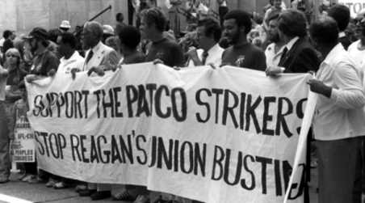
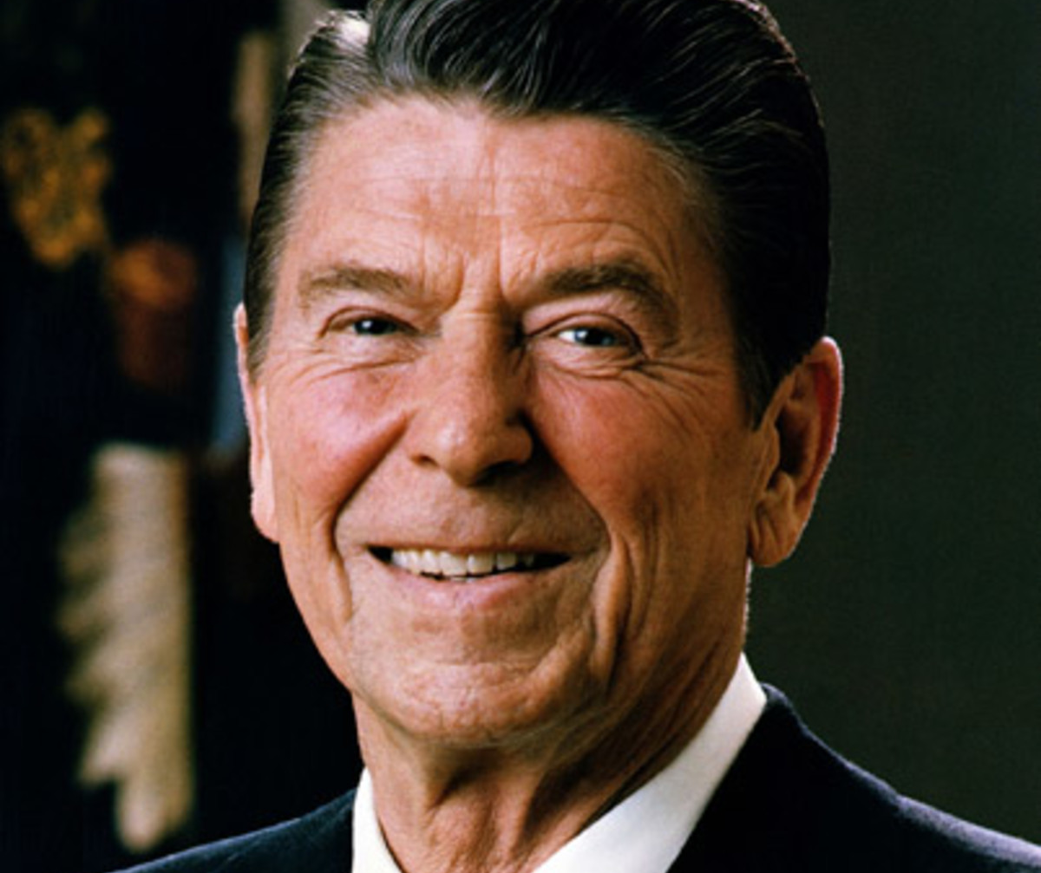
Ronald Reagan
Paleoconservative and staunch proponent of supply-side economics
Long-standing personal and professional ties to intellectual and civil society organizations of the right
Crushed PATCO (Air Traffic Controllers) strike in 1981
The last Cold Warrior

Slide 15
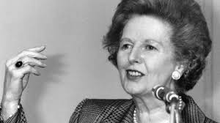
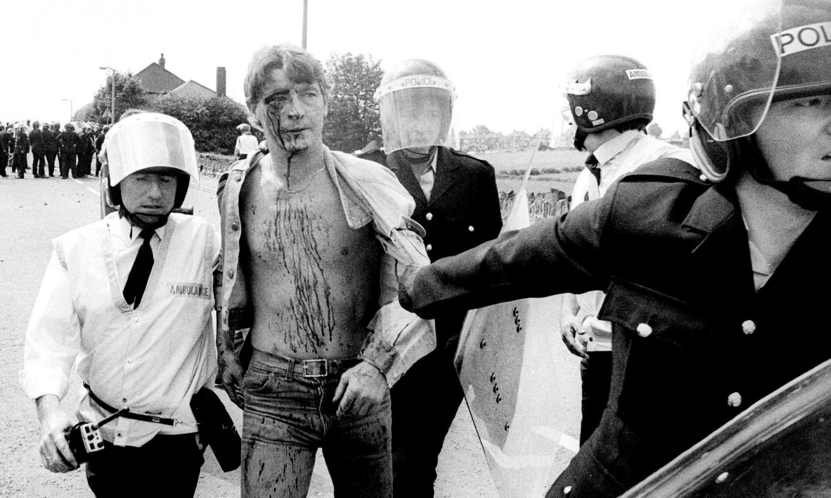
British Neoliberalism
Margaret Thatcher elected prime minister 1979
Used the state to break unions, including contentious 1984 coal-miners’ strike
Sold off state-owned industries

Slide 16
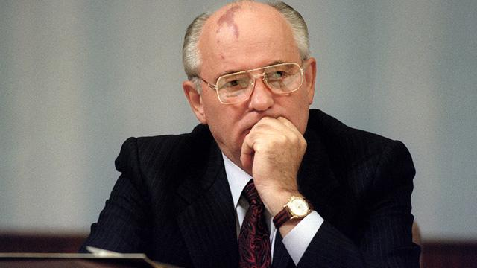
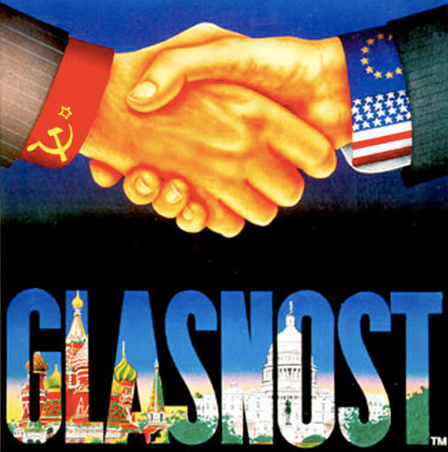
Glasnost and Perestroika
Clear by the 1970s USSR was falling behind not catching up to the capitalist West
Gorbachev introduced Glasnost (openness) and Perestroika (restructuring) initially to preserve socialist regime by making it more competitive
Allowed private ownership of previously state-owned enterprises
Opened Soviet economy to foreign capital

Slide 17
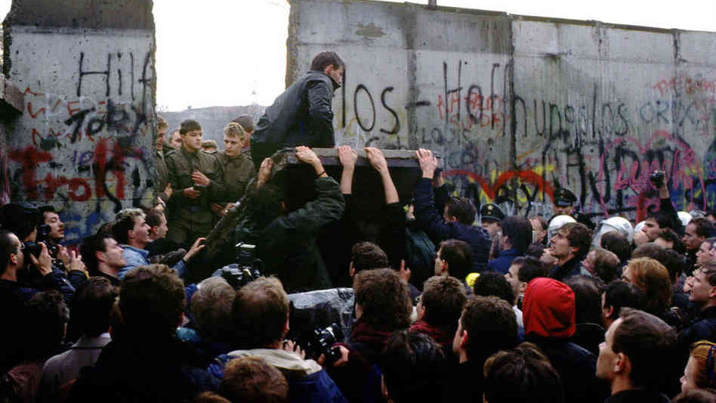
Fall of the Berlin Wall, 1989

Slide 18
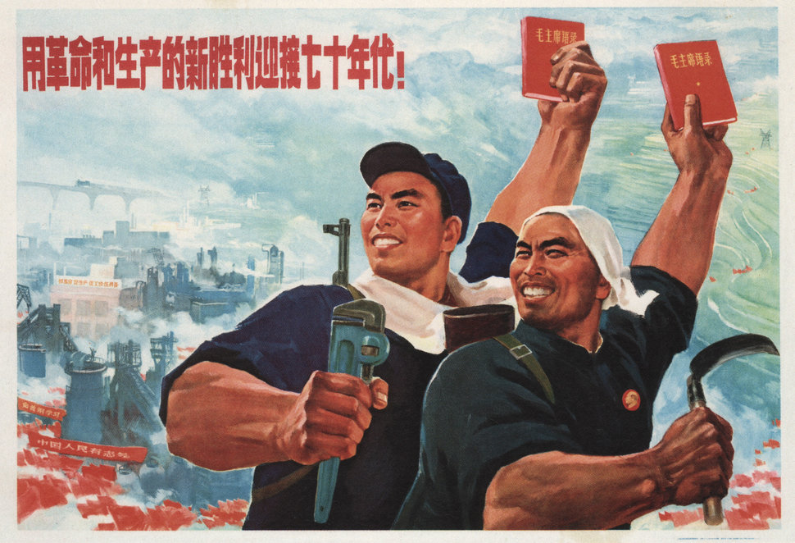
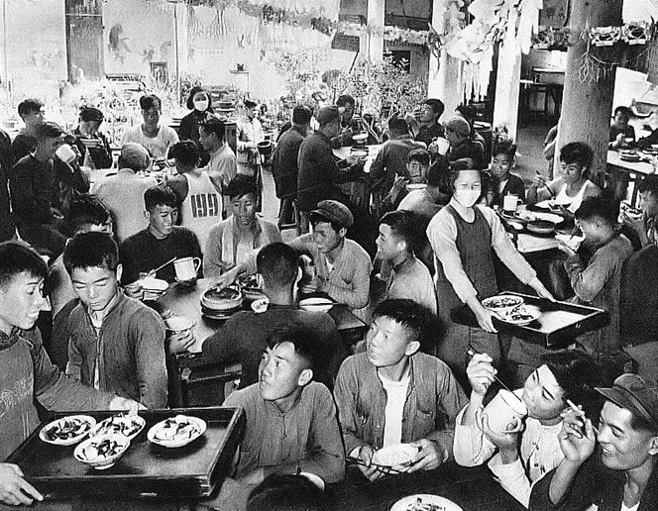
Communist China
Rural majority under agrarian communes
Industry under State Owned Enterprises (SOEs)
Both communes and SOEs ensured job security and social protections
SOEs were modestly profitable, agrarian communes lagged far behind modern capitalist agriculture

Slide 19
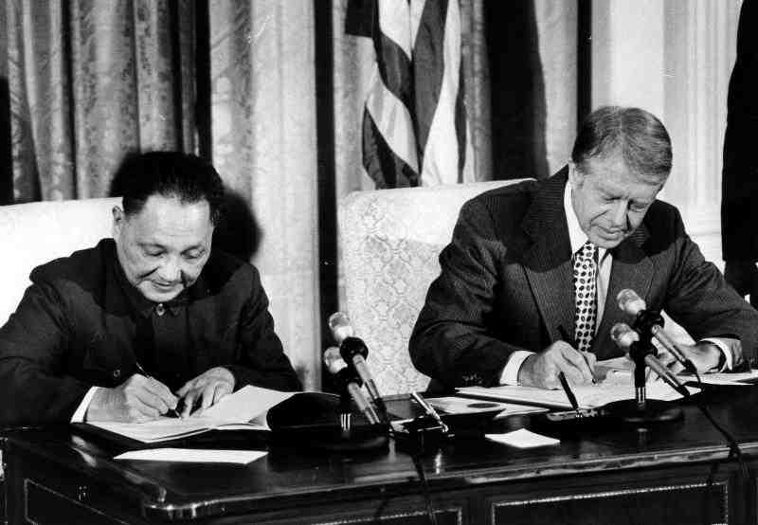
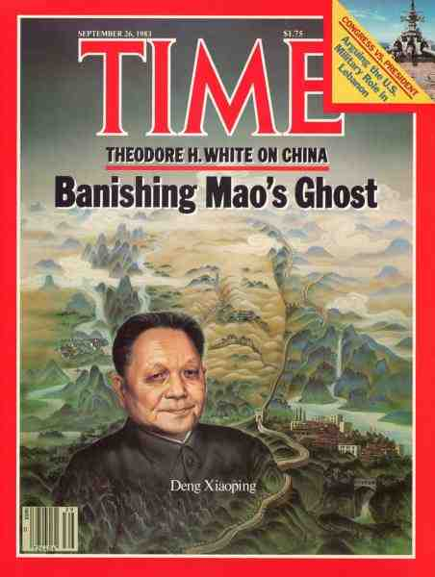
小康社会
Deng Xiaoping replaced Mao following the latter’s death
Pursued policy of xiaokang (prosperous society) based on four modernizations: agriculture, industry, education, science
Improved diplomatic relations with the capitalist world
Opened “special economic zones” to foreign capital to facilitate technology transfers

Slide 20
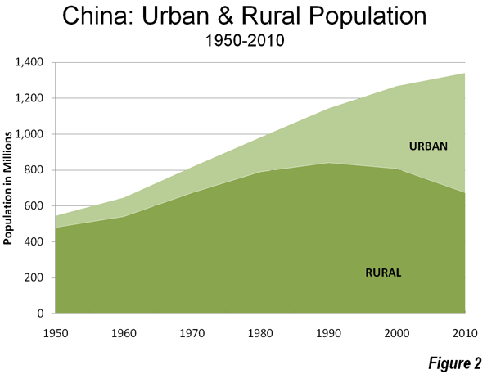
Capitalism in China
Agrarian communes replaced by township and village enterprises (TVEs) encourage entrepreneurialism, flexible labor, and market competition
1980-present largest rural to urban migration in human history
SOEs competed with private foreign business, introduced flexible labor, and managerial autonomy with profit incentives
By early twenty-first century SOEs and TVEs were open to complete privatization

Slide 21
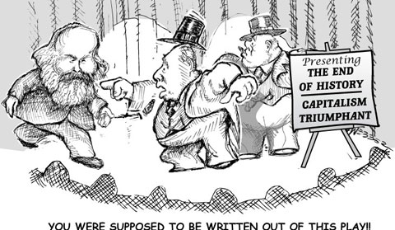
“End of History” or “Unipolar Moment”?
Following fall of Soviet Union U.S. enjoyed unchallenged global economic and military superiority
Francis Fukuyama famously declared the “end of history” in 1992
US at war from 2001-present
Increasingly social polarization worldwide since 2007-8 financial crisis

